Slide 1
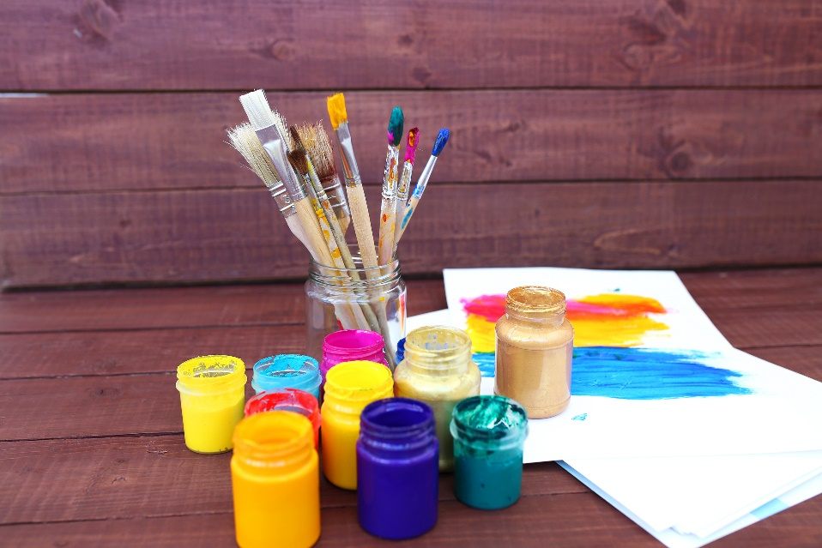
Fonts and Colors
Font Families
Font Attributes
Web Colors

Slide 2
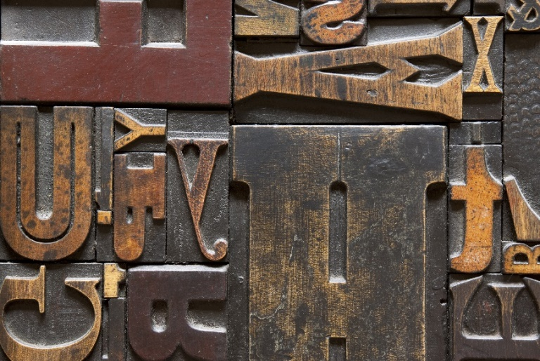
See Also
https://www.w3schools.com/cssref/css_websafe_fonts.asp
https://www.w3schools.com/colors/colors_picker.asp
https://en.wikipedia.org/wiki/Web_colors

Slide 3

In the Book
Chapter 8:
Styling with Fonts
and Colors

Slide 4

What’s a Serif?
Georgia
This is a SERIF font
Non-SERIF font
Arial

Slide 5














Font Families
Serif Family
Monospace Family
Sans-serif Family
Cursive Family
Fantasy Family

Slide 6
Specifying Font Family
I really want this
If Verdana is not available
I guess I could settle for this
body {
font-family: Verdana, Geneva, Arial, sans-serif;
}
Just pick SOMETHING from this family
The “font-family” is a list of preferred fonts listed in order of preference
Put a general font-family last in the list

Slide 7
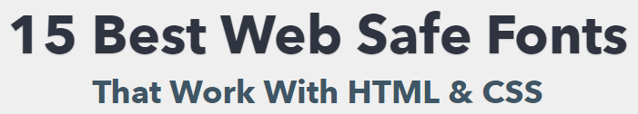
Who has What Fonts?
Usually Windows and Macintosh
Andale Mono
Arial
Arial Black
Comic Sans
Courier New
Georgia
Impact
Times New Roman
Trebuchet MS
Verdana
Usually Macintosh Only
Geneva
Courier
Helvetica
Times
https://websitesetup.org/web-safe-fonts-html-css/

Slide 8
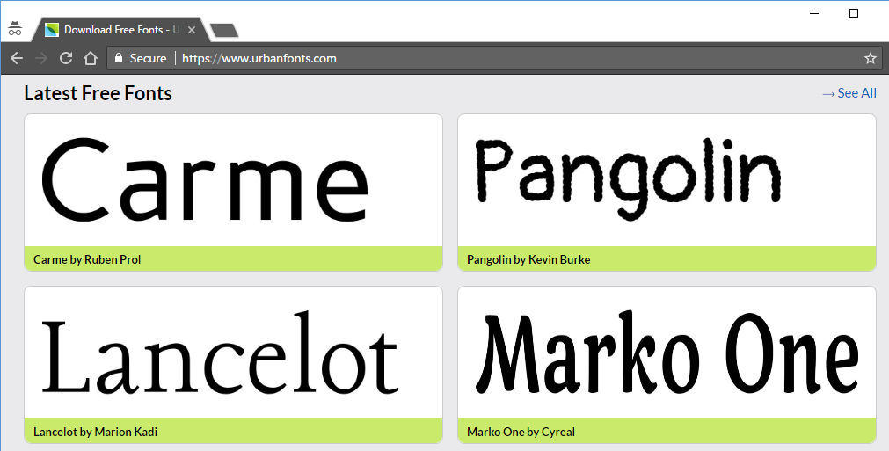
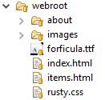
Web Fonts
Find a font on the web (free or purchased).
Upload file to your web site (or use an external URL).

Slide 9
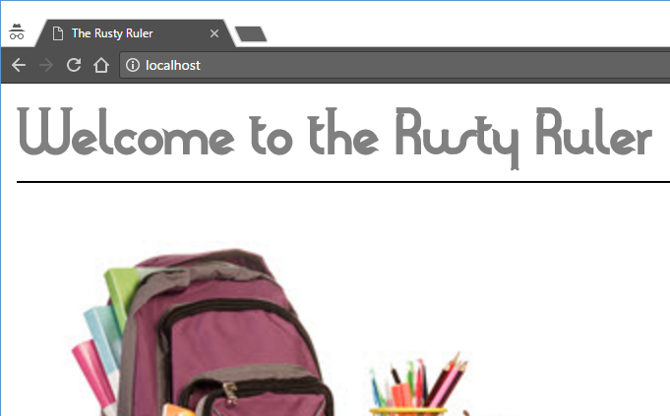
Web Fonts
Add “font-face” to your CSS file.
Reference the font as needed.
Name we want to use
rusty.css
@font-face {
font-family: Forticula;
src : url("forficula.ttf");
}
h1 {
border-bottom: 1px solid black;
font-family: Forticula;
}
Where to find it
Name we gave

Slide 10
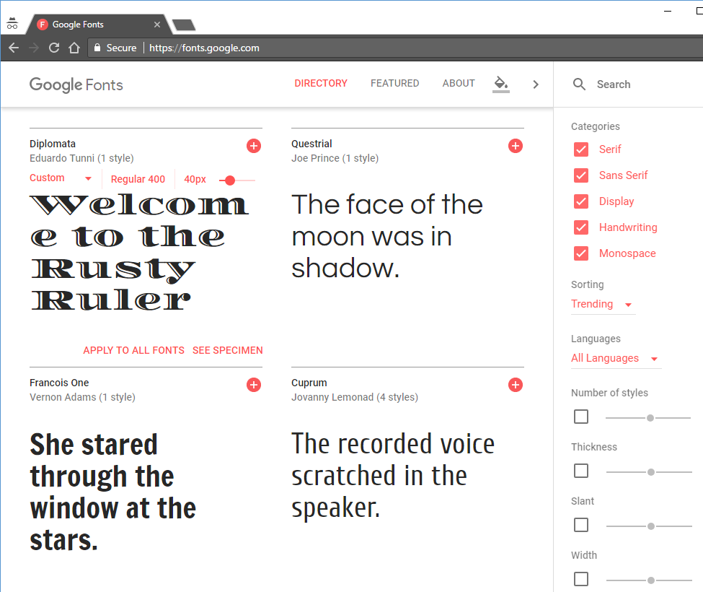
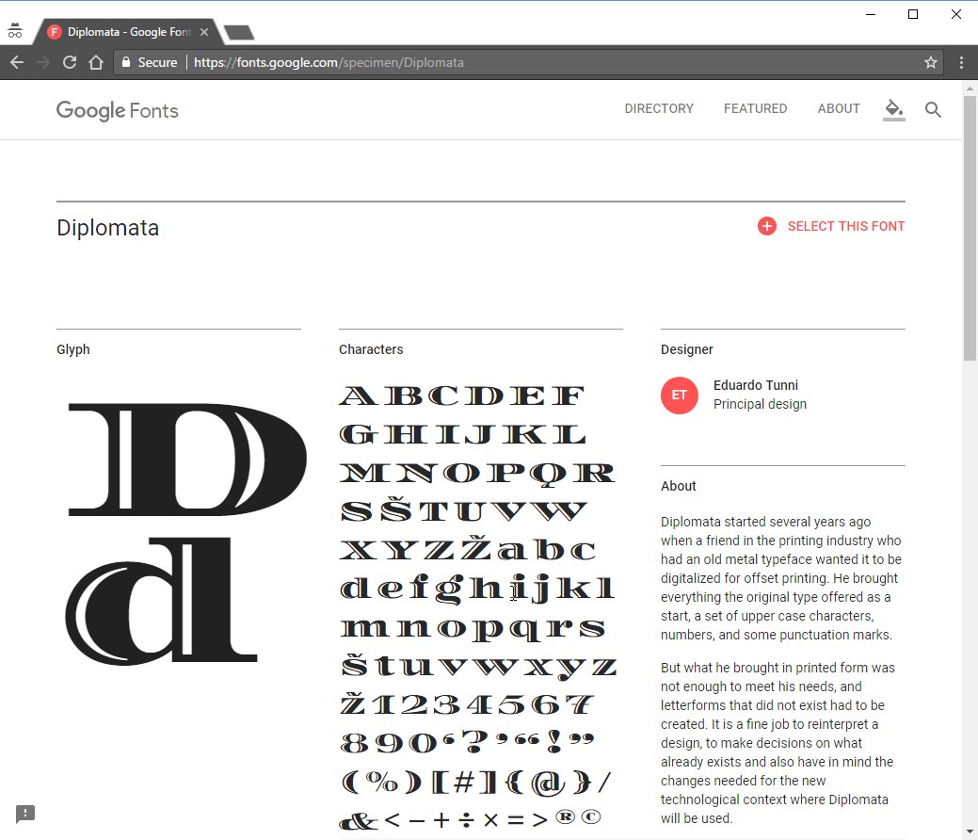
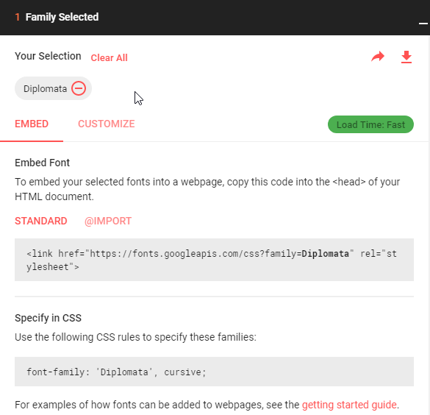
Google Fonts

Slide 11
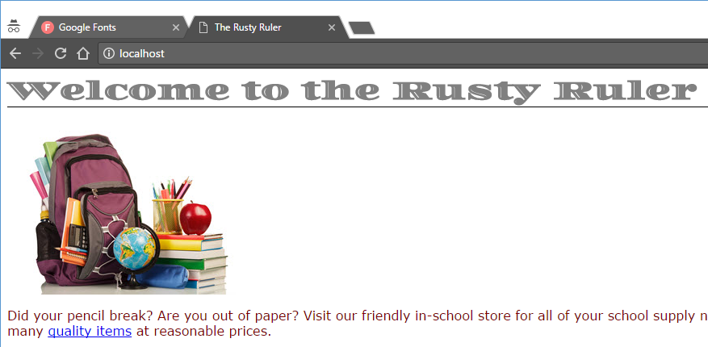
Google Fonts
index.html
<head>
<title>The Rusty Ruler</title>
<link type="text/css" rel="stylesheet" href="rusty.css">
<link href="https://fonts.googleapis.com/css?family=Diplomata" rel="stylesheet">
</head>
<body>
<h1>Welcome to the Rusty Ruler</h1>
...
h1 {
border-bottom: 1px solid black;
font-family: 'Diplomata', cursive;
}
rusty.css

Slide 12

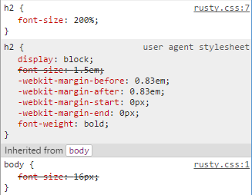
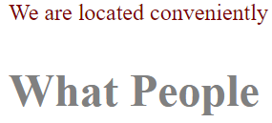
Font Size
body {
font-size: 16px;
}
h2 {
font-size: 200%;
}
16 pixels
16 pixels
32 pixels

Slide 13
Meet the “em”
… iIjJkKlLmMnNoOpP …
The letter ‘M’ (pronounced “em”) is the widest letter in a font.
The long dash (em-dash) –
The short dash (en-dash) -
Changed over the years. We now use “em” to mean “the height of the font”.
We use it as a scaling factor (much like percent).
Many prefer this way to specify size.

Slide 14
Font Size
body {
font-size: 16px;
}
h2 {
font-size: 2.0em;
font-size: 0.25em;
}
16 pixels
Percent and “em” are nearly the same
http://kyleschaeffer.com/user-experience/css-font-size-em-vs-px-vs-pt-vs/

Slide 15
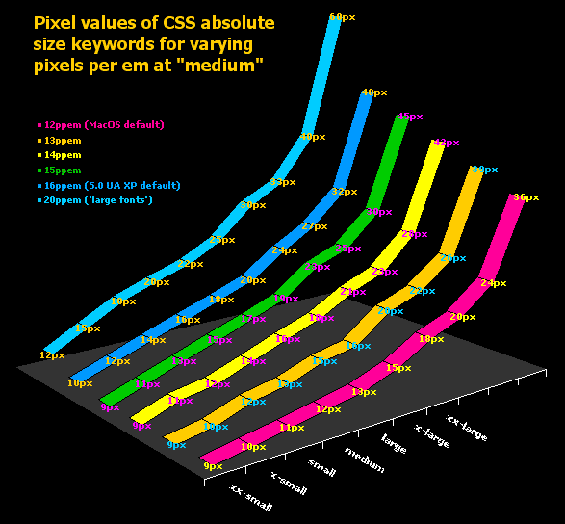
Font Size
http://style.cleverchimp.com/font_size_intervals/altintervals.html
body {
font-size: xx-small;
font-size: x-small;
font-size: small;
font-size: medium;
font-size: large;
font-size: x-large;
font-size: xx-large;
}

Slide 16
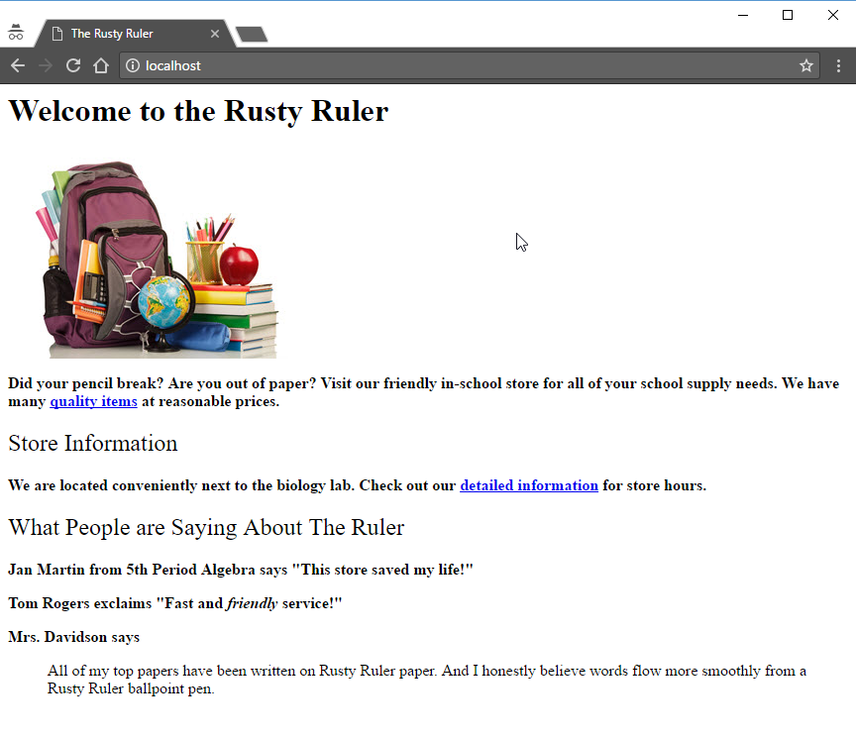
Font Weight
p {
font-weight: bold;
}
h2 {
font-weight: normal;
}

Slide 17
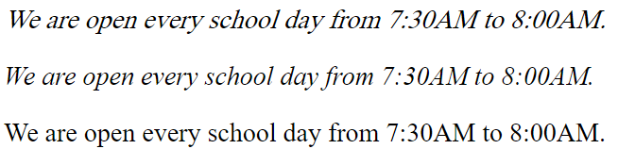
Font Style
font-style: oblique;
font-style: italic;
font-style: normal;
Sometimes the font has only italic or oblique
Sometimes the browser picks
Just use “italic”

Slide 18
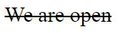
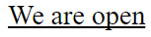
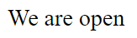
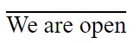
Font Decoration
text-decoration: line-through;
text-decoration: underline;
text-decoration: none;
text-decoration: overline;

Slide 19
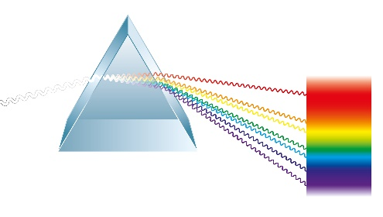
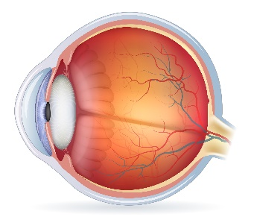
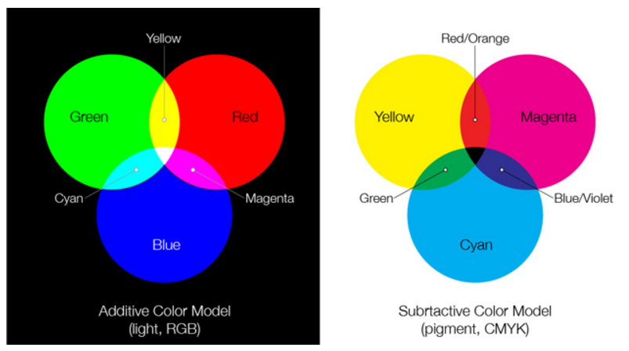
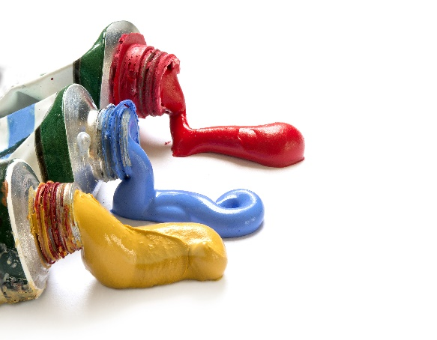
Web Colors
Paint
Light

Slide 20
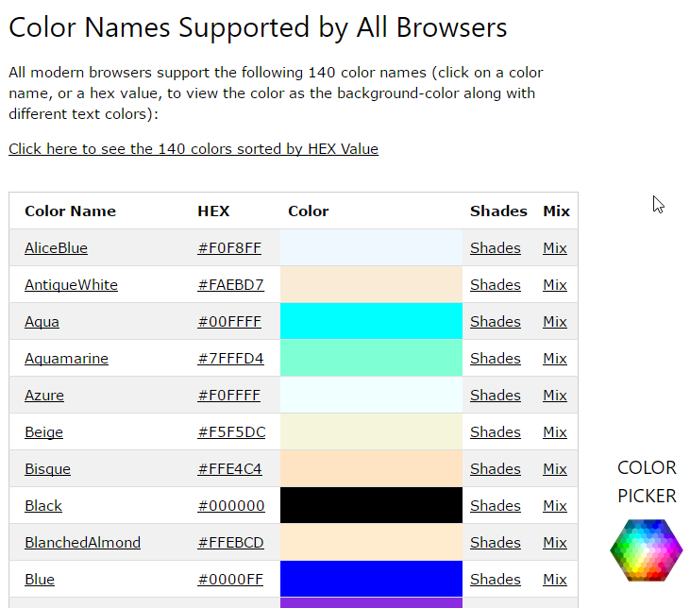
Color by Name
https://www.w3schools.com/colors/colors_names.asp
background-color: aqua;
color: fuchsia;
color: #005090;
color: #0BEEF0;
color: rgb(80%, 40%, 0%);
color: rgb(204, 102, 0);
R G B

Slide 21
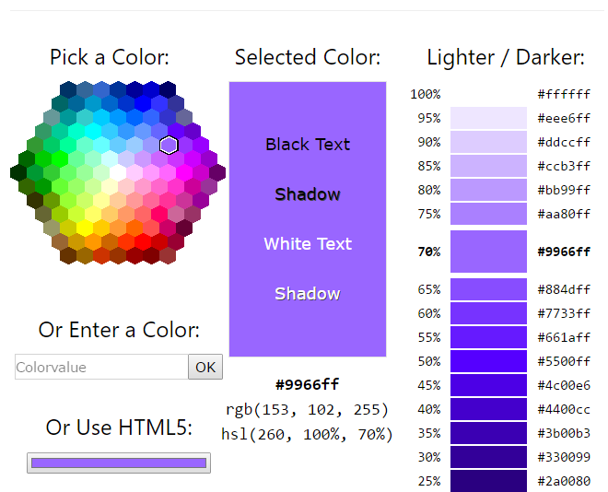
Color Picker

Slide 22
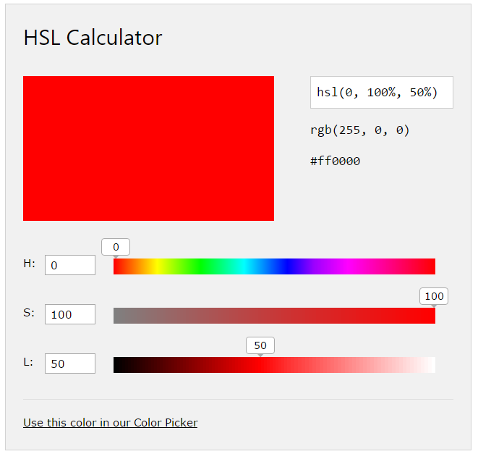
Hue, Saturation, Lightness
color: hsl(0, 100%, 50%);

Slide 23
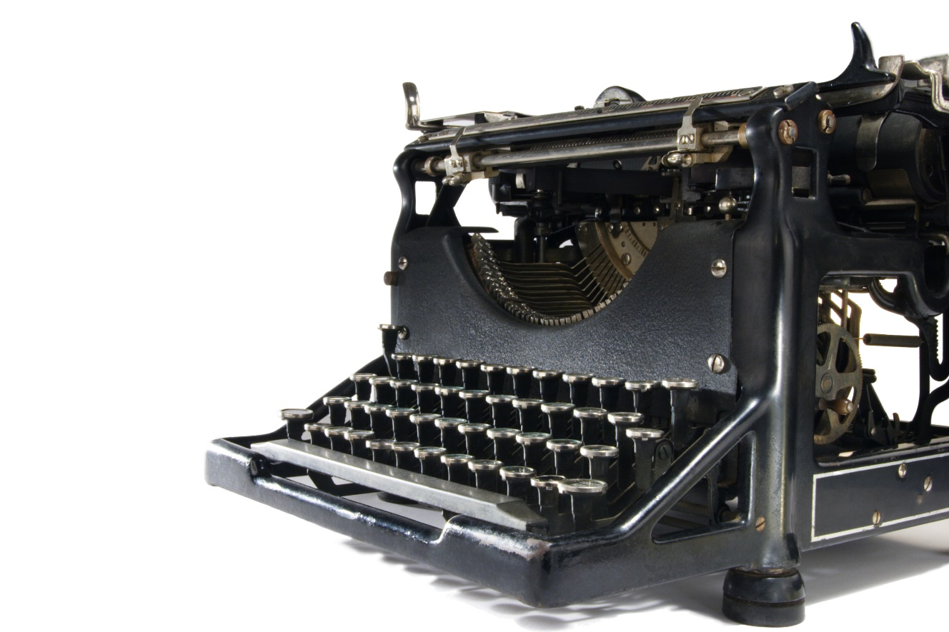
Tinkering
Modify a previous exercise or example.
Change <h1> to use a fancy Google Font of your choice.
Change the background color of the page to a custom color of your choosing.

